Slide 1

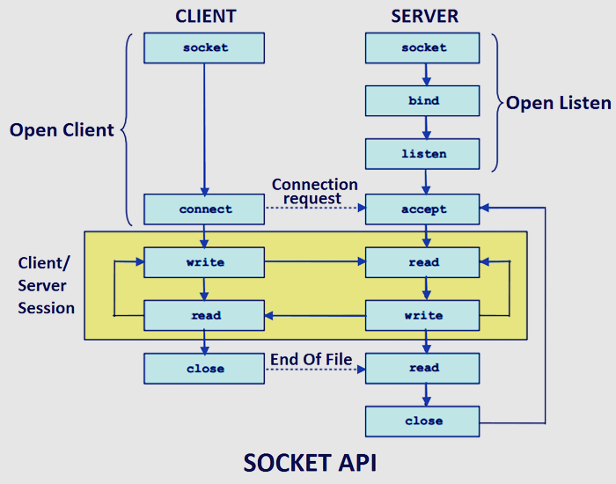
TCP Socket Programming Model
Notes:
Note that at the end of client communication, its sending End of File and is being read by server with 0 bytes of data. Need to handle this with reading 0 bytes

